Slide 1



Course : Data Science
Lecture On : Pre exam session
Instructor : Manish Kumar

Slide 2
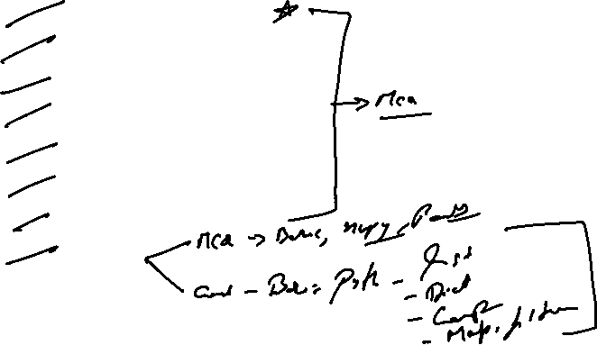
KEY - TOPICS
Random Variables
Expected Values
Basic Probability
Central Limit Theorem
Hypothesis Testing
EDA
SQL
Python

Slide 3
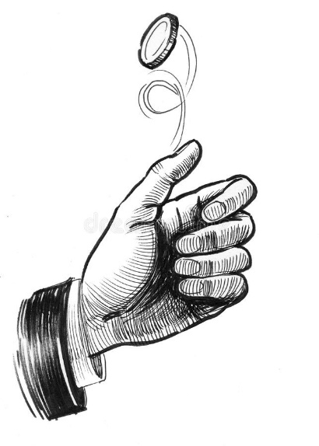
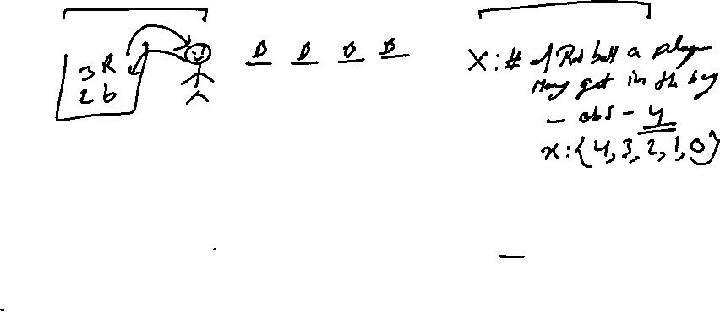
Random Variables
“ A Random Variable is a set of possible values from a random experiment. “
X : Number of heads in the toss of two coins
X : {2, 1, 0}
Y: Number of tails in the toss of two coins
Y : {2, 1, 0}
If the person tossing two coins get HH +20 else -10
Z: the amount a player can win
Z : {+20, -10}
H H
H T
T H
T T
Notes:
It is used to describe the characteristics of data in short it helps us in knowing our data better.

Slide 4
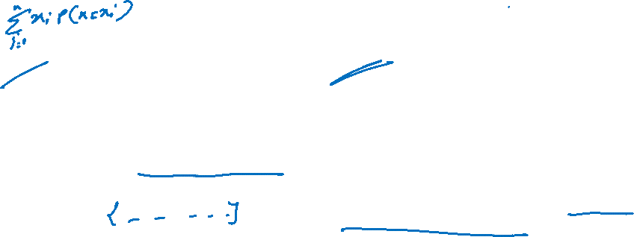
Expected Value
The expected value for a variable X is the value of X we would “expect” to get after performing the experiment once. It is also called the expectation, average, and mean value
Discrete Probability Distributions
Continuous Probability Distributions
A discrete distribution describes the probability of occurrence of each value of a discrete random variable. A discrete random variable is a random variable that has countable values, such as a list of non-negative integers. Ex. A coin flip
A continuous distribution describes the probabilities of the possible values of a continuous random variable. A continuous random variable is a random variable with a set of possible values (known as the range) that is infinite and uncountable Ex. Commute time of an upgrad employee

Slide 5



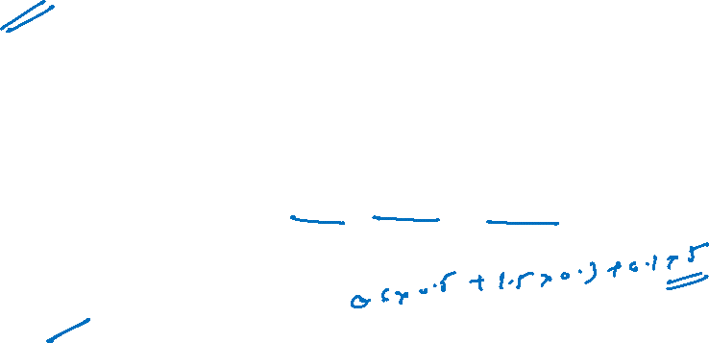
Poll
One game that is popular at some carnivals and amusement parks involves selecting a floating plastic duck at random from a pond full of ducks.
In most cases, the letter S, M, or L appears on the bottom of the duck, signifying that the winner receives a small, medium, or large prize, respectively.
The duck is then returned to the pond for the next game. Although the prizes are typically toys, crafts, etc., suppose that the monetary values of the prizes are as follows:
Small is $ 0.50, Medium is$1.50, and Large is $5.00
The probabilities of winning an item on duck selection are as follows:
Small 60%, Medium 30%, and Large is 10%.
What is the expected value of money that the person will win playing this game?
+1
+1.25
-1.25
27-06-2021
11

Slide 6
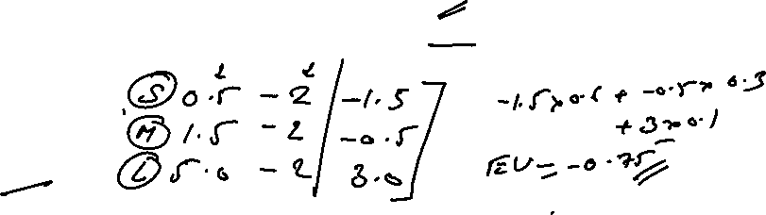
Poll
Revisiting the carnival, recall that when selecting a duck, the average monetary value of the prizes you win per game is $𝟏.𝟐𝟓 How can the charity running the carnival make any money if it is paying out $𝟏.𝟐𝟓 to each player on average for each game?
To address this, in most cases a player must pay to play a game, and that is where the organizers would earn its money.
Question: Imagine that the cost to play the game is $ 2.0 What are the expected net earnings? What are the expected net winnings for a player?
A) 0.25
B) -0.25
C) -0.75
27-06-2021
11

Slide 7
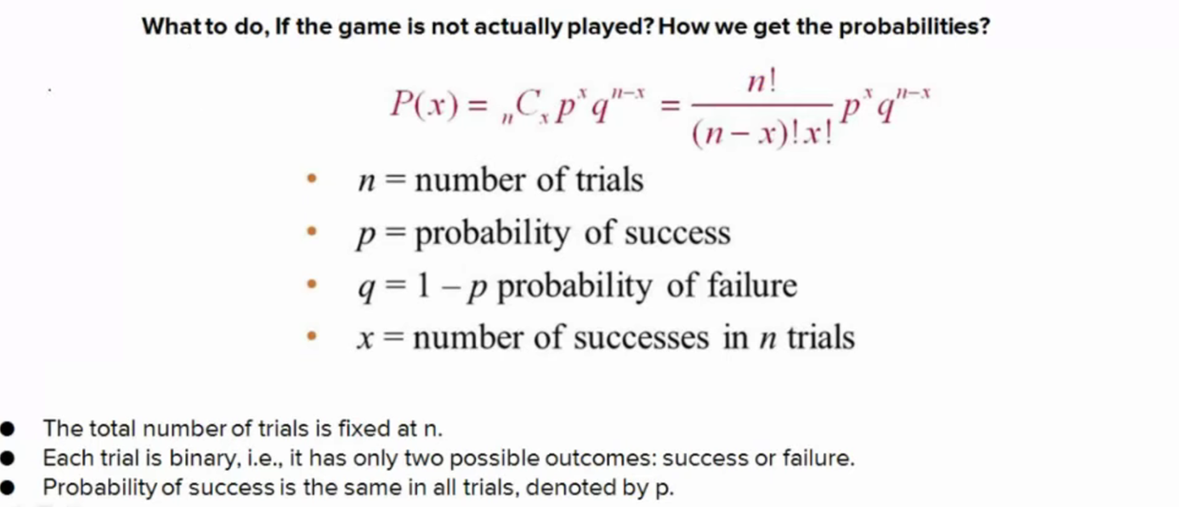
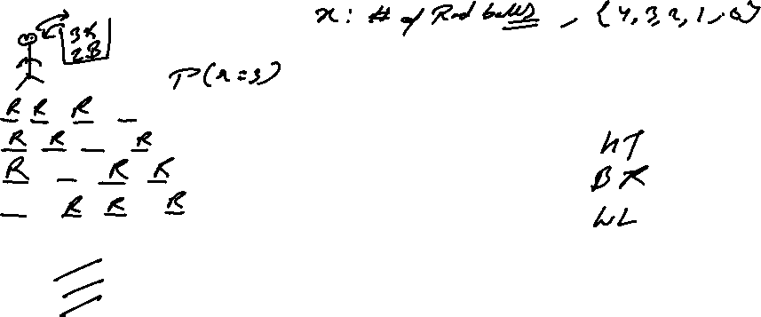
Expected Value

Slide 8
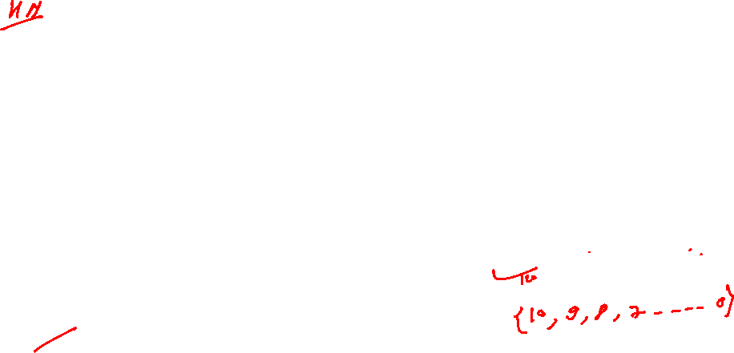
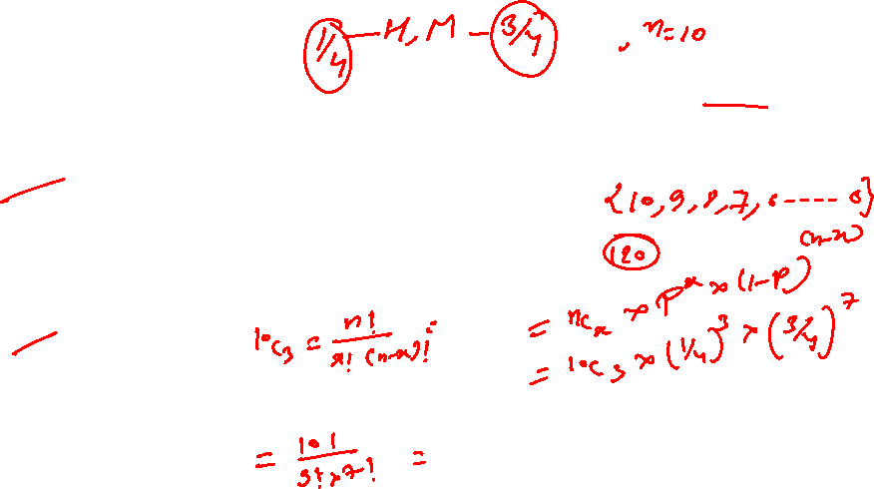
0.33 ● 0.10 ● 0.26
Poll
The probability of a man hitting the target at a shooting range is 1/4. If he shoots 10 times, what is the probability that he hits the target exactly three times?
Question-1: Choose the correct Random Variable that quantifies the experiment.
● X : Number of correct hits.
● X: Number of times he hits the target exactly 3 times.
● X: Number of subsequent correct hits.
Question-2: What will be the range of the random variable X?
● 0<=X<=3
● 0<=X<=10
● 1<=X<=10
Question-3: What is the probability that he hits the target exactly three times?
● 0.15
● 0.25

Slide 9
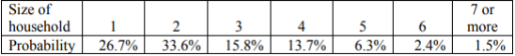
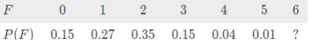
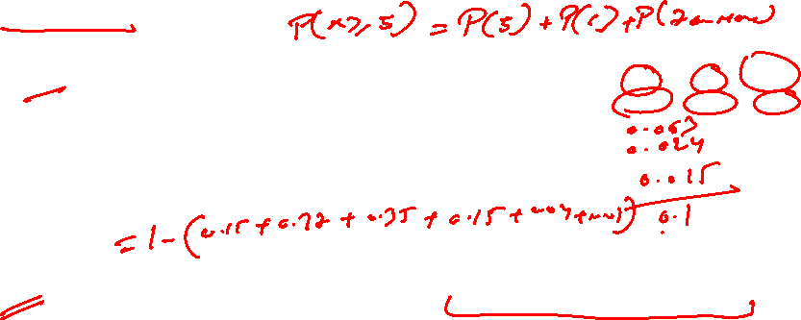
0.33 ● 0.10 ● 0.26
Poll
Question-1: The 2010 U.S. Census found the chance of a household being a certain size. The data is in the table ("Households by age," 2013). What is the probability that a household will have at least 5 members?
0.33
0.10
0.26
Question-2: A discrete probability distribution of scoring runs in one throw of a ball by a particular batsman in a cricket match is given in the table. Find the missing probability
0.3
0.02
0.03

Slide 10
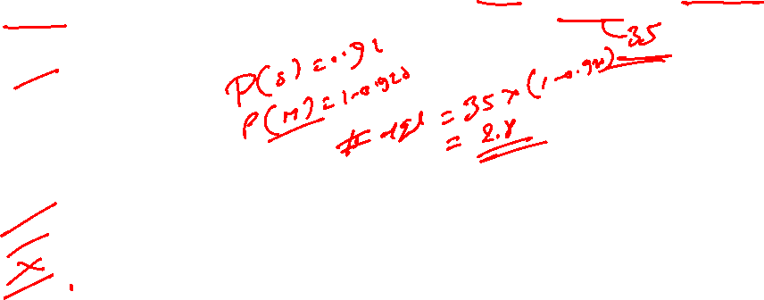
0.33 ● 0.10 ● 0.26
Poll
Question - 3: A hockey goaltender has a save percentage of 0.920. What would be the expected number of goals scored on this goaltender in a game where she faced 35 shots?
5.2
2.8
2
2.5
Question - 4: Which of the following is not a property of a Binomial Experiment?
All trials are identical.
Each trial has only two possible outcomes.
The probability of success may change from trial to trial.
The purpose of the experiment is to determine the number of successes that occurs during the n trials.

Slide 11
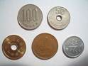


Descriptive Statistics
“ A descriptive statistic is a summary statistic that quantitatively describes or summarizes features of a collection of information. “
Measurement level of Data
Cardinal Numbers
A Cardinal Number says how many of something there are, such as one, two, three ..
It answers the question "How Many?“ , Example: here are five coins
Ordinal Numbers
An Ordinal Number tells us the position of something in a list.1st, 2nd, 3rd, 4th, 5th and so on, eg: Grades, Star Reviews, Position in Race, Date
Nominal Numbers
A Nominal Number is a number used only as a name, or to identify something (not as an actual value or position) eg: Brand Name, ZipCode, Gender
Notes:
It is used to describe the characteristics of data in short it helps us in knowing our data better.

Slide 12
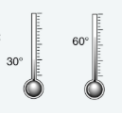
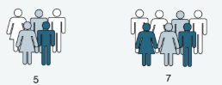
Measurement level of Data
Interval: Data at this level can be ordered as it is in a range of values and meaningful differences between the data points can be calculated. eg: Temperature in Celsius, Year of Birth
Temperature In degree & Fahrenheit
Ratio: Data at this level is similar to interval level with added property of an inherent zero. Mathematical calculations can be performed on these data points. eg: Height, Age, Weight

Slide 13
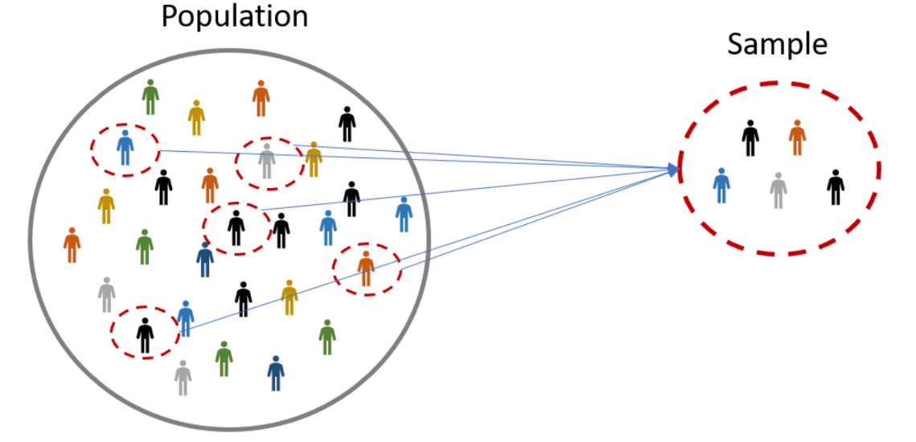

Central Limit Theorem
The Problem: Let’s say that, for a business application, you want to find out the average number of times people in urban India visited malls last year. That’s 400 million (40 crore) people! You can't possibly go and ask every single person how many times they visited the mall. That’s a costly and time-consuming process. How can you reduce the time and money spent on finding this number?

Slide 14
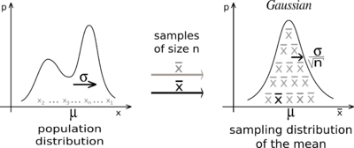
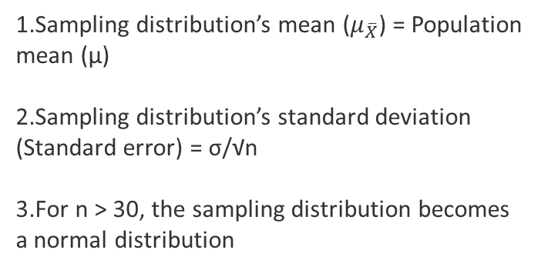
Central Limit Theorem
The central limit theorem says that, for any kind of data, provided a high number of samples has been taken, the following properties hold true:
Sampling distribution’s mean ($μ_{\overline{X}}$) = Population mean (μ)
Sampling distribution’s standard deviation (Standard error) = σ/√n
For n > 30, the sampling distribution becomes a normal distribution

Slide 15
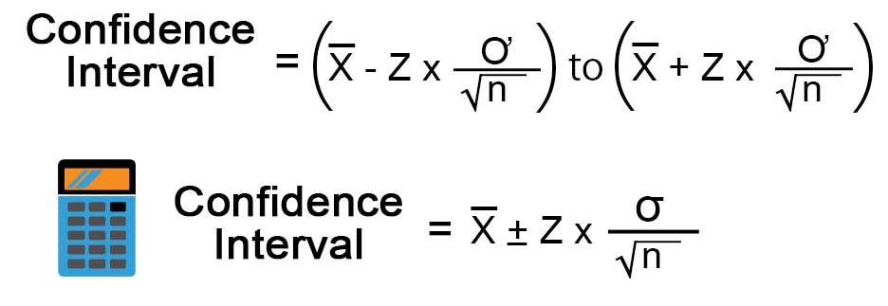
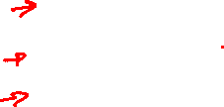
Central Limit Theorem
Calculating population parameters from sample parameters
Confidence Level | Z
90% | +/- 1.65
95% | +/- 1.96
99% | +/-2.58
Where Z is the Z-score associated with y% confidence level

Slide 16
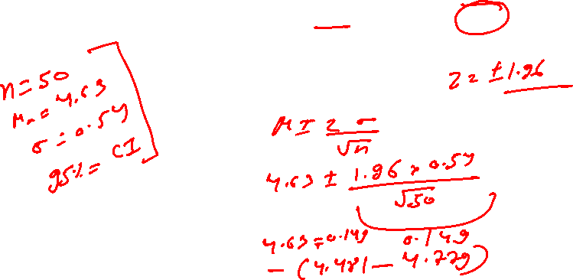
Poll
A simple random sample of 50 adults women's is obtained, and each person's red blood cell count (in cells per microliter) is measured The sample mean is 4.63. The population standard deviation for red blood cell counts is 0.54. Construct the 95% confidence interval estimate for the mean red blood cell counts of adults.

Slide 17
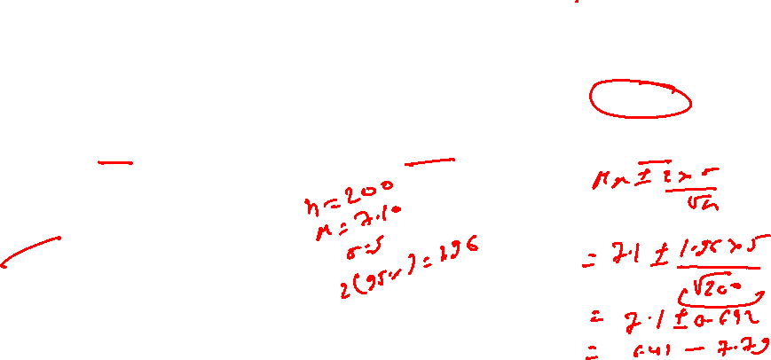
(6.10, 8.10) ● (6.41, 7.79) ● (6.57, 7.63) ● (7.10, 8.48)
Poll
Researchers are concerned about the impact of students working while they are enrolled in classes, and they’d like to know if students work too much and therefore are spending less time on their classes than they should be. First, the researchers need to find out, on average, how many hours a week students are working. They know from previous studies that the standard deviation of this variable is about 5 hours
A survey of 200 students provides a sample mean of 7.10 hours worked. What is a 95% confidence interval based on this sample?
(6.10, 8.10)
(6.41, 7.79)
(6.57, 7.63)
(7.10, 8.48)

Slide 18
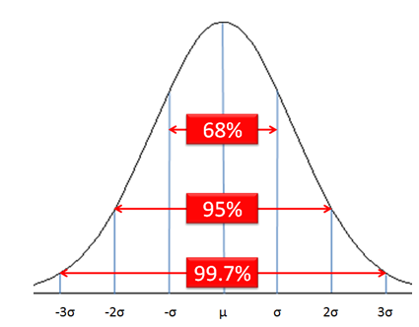
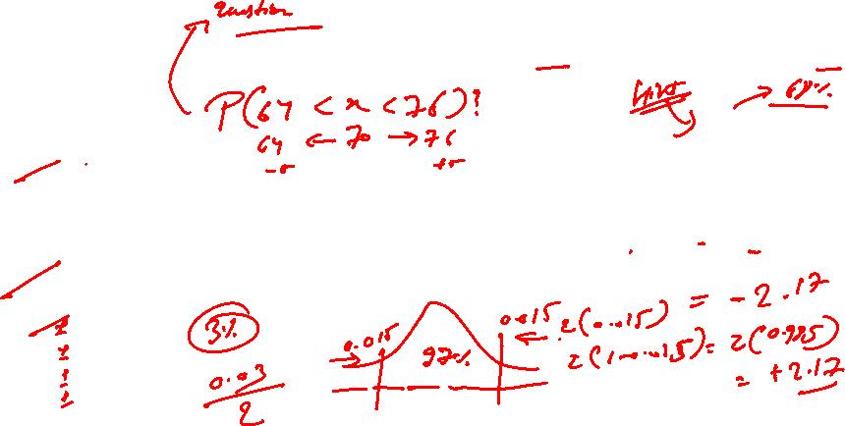
(6.10, 8.10) ● (6.41, 7.79) ● (6.57, 7.63) ● (7.10, 8.48)
Poll
A set of biology exam scores are normally distributed with a mean of 70 points and a standard deviation of 6 points. Let X represent the score on a randomly selected exam from this set.
0.841
0.158
0.68
Cannot say from the information provided
What should be the value of z used in a 97% confidence interval?
2.17
1.40
1.81
1.89

Slide 19
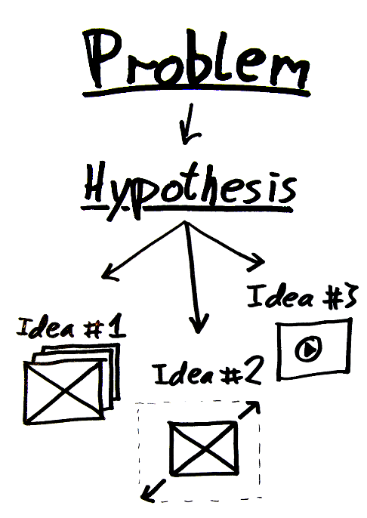
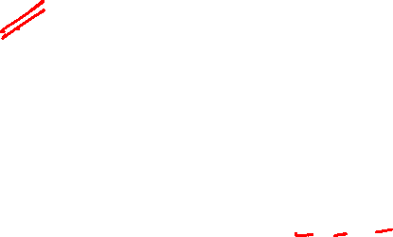
Hypothesis Testing
Hypothesis : a claim or an assumption that we make about one or more population parameters
Types of hypothesis:
Null hypothesis (H₀)
Makes an assumption about the status quo
Always contains the symbols ‘=’, ‘≤’ or ‘≥’
Alternate hypothesis (H₁)
Challenges and complements the null hypothesis
Always contains the symbols ‘≠’, ‘<’ or ‘>’

Slide 20
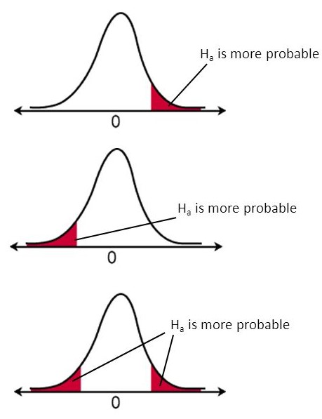
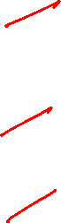
Hypothesis Testing
Types of tests:
Upper-tailed test
The critical region lies on the right side of the distribution
The alternate hypothesis contains the > sign
Lower-tailed test
The critical region lies on the left side of the distribution
The alternate hypothesis contains the < sign
Two-tailed test
The critical region lies on both sides of the distribution
The alternate hypothesis contains the ≠ sign

Slide 21
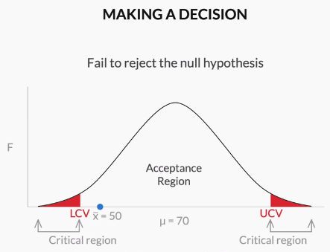
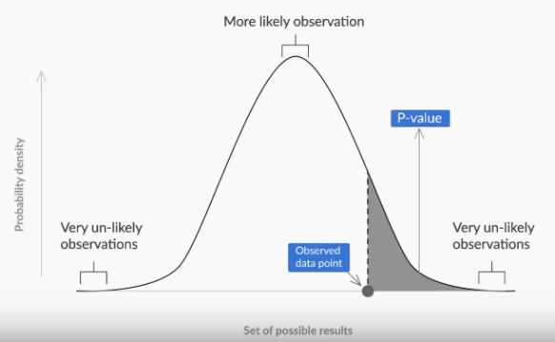
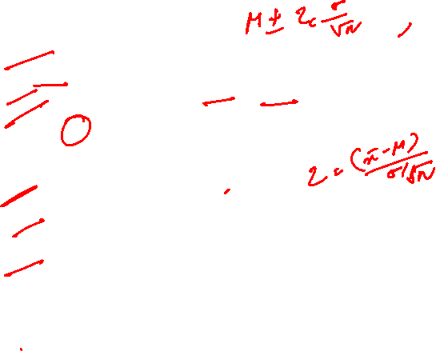
Hypothesis Testing
Making a decision
- Critical value method:
Calculate the value of Zc from the given value of α (significance level)
Calculate the critical values (UCV and LCV) from the value of Zc
Make the decision on the basis of the value of the sample mean ¯x with respect to the critical values (UCV AND LCV)
P-value method:
Calculate the value of z-score for the sample mean point on the distribution
Calculate the p-value from the cumulative probability for the given z-score using the z-table
Make a decision on the basis of the p-value (multiply it by 2 for a two-tailed test) with respect to the given value of α (significance value).

Slide 22

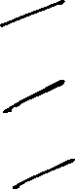
P-value is used to determine the significance of results after a hypothesis test in statistics. P-value helps the readers to draw conclusions and is always between 0 and 1.taking alpha value as 0.05
• P- Value > 0.05 denotes weak evidence against the null hypothesis which means the null hypothesis cannot be rejected.
• P-value <= 0.05 denotes strong evidence against the null hypothesis which means the null hypothesis can be rejected.
• P-value = 0.05 is the marginal value indicating it is possible to go either way.

Slide 23

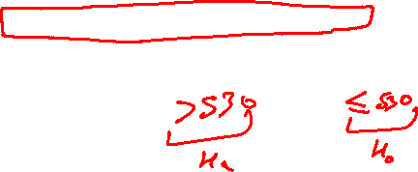
Poll
Formulating Null and Alternate Hypothesis
Example-1: A restaurant owner installed a new automated drink machine The machine is designed to dispense 530 mL of liquid on the medium size setting. The owner suspects that the machine may be dispensing too much in medium drinks. They decide to take a sample of 30 medium drinks to see if the average amount is significantly greater than 530 mi.

Slide 24
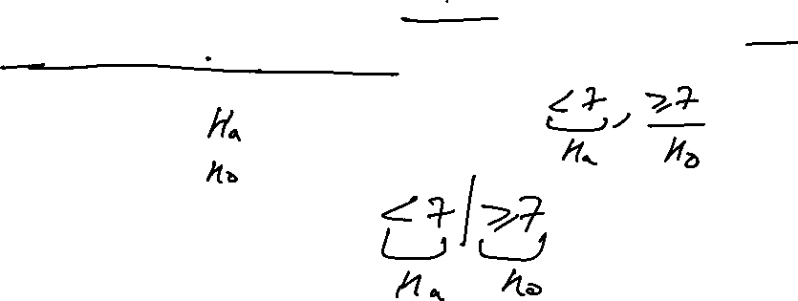
Poll
Formulating Null and Alternate Hypothesis
Example-2: A city had an unemployment rate of 7%, percent. The mayor pledged to lower this figure and supported programs to decrease unemployment. A group of citizens wanted to test if the unemployment rate had actually decreased, so they obtained a random sample of citizens to see what proportion of the sample was unemployed.

Slide 25
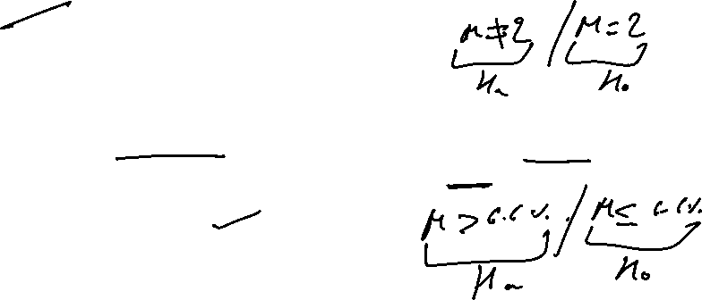
Poll
Formulating Null and Alternate Hypothesis
Question-1: We want to test whether the mean GPA of students in American colleges is different from 2.0 (out of 4.0). The null and alternative hypotheses are:
H0 = 2 , Ha !=2
H0!=2, Ha=2
H0>2, Ha<2
Question-2: In an issue of U.S. News and World Report, an article on school standards stated that about half of all students in France, Germany, and Israel take advanced placement exams and a third pass. The same article stated that 6.6% of U.S. students take advanced placement exams and 4.4% pass. Test if the percentage of U.S. students who take advanced placement exams is more than 6.6%. State the null and alternative hypotheses.
H0>0.066, Ha = 0.066
H0<=0.066, Ha>0.066
H0>=0.066, Ha<0.066

Slide 26
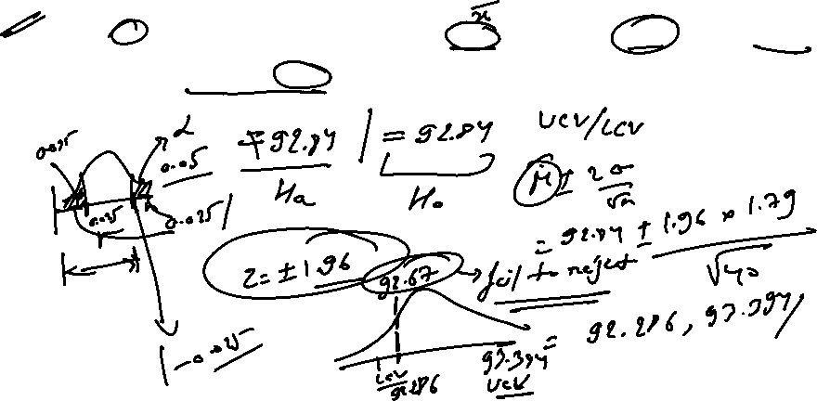


Poll
Critical Value method
A sample of 40 new baseballs had a bounce height mean of 92.67 inches and a SD of 1.79 inches. Use a .05 sig. level to determine whether there is sufficient evidence to support the claim that the new balls have bounce heights with a mean different from 92.84 inches.

Slide 27
Poll
Critical Value method
A sample of 40 new baseballs had a bounce height mean of 92.67 inches and a SD of 1.79 inches. Use a .05 sig. level to determine whether there is sufficient evidence to support the claim that the new balls have bounce heights with a mean different from 92.84 inches. (a previous test figure).

Slide 28
Poll
P-Value method
A sample of 40 new baseballs had a bounce height mean of 92.67 inches and a SD of 1.79 inches. Use a .05 sig. level to determine whether there is sufficient evidence to support the claim that the new balls have bounce heights with a mean different from 92.84 inches.

Slide 29
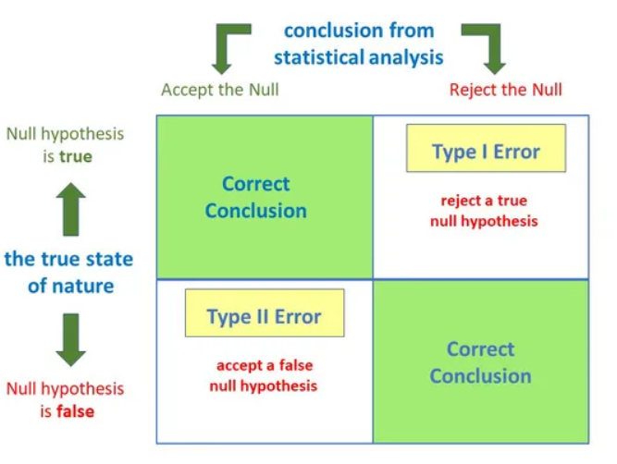
Type I and Type II Error
A type I error occurs when the null hypothesis is true but is rejected.
A type II error occurs when the null hypothesis is false, but erroneously fails to be rejected.

Slide 30

Suppose we want to test whether boys, on average, score higher than 600 on the SAT verbal section or not.
Suppose we choose our α to be .05. Since this is a one-tailed test, we find our critical value in the upper tail of the sampling distribution, which is z = 1.645. Suppose we also happen to know that the standard deviation for boys SAT verbal section scores is 50.
Now we collect the data using a random sample of 20 Boys and their verbal section scores:
589 633 597 631 639
589 608 638 592 641
645 631 647 607 628
638 603 626 586 608

Slide 31

Determine the null and alternative hypotheses.

Slide 32
This, gives us the hypotheses:
H0 : µ ≤ 600
H1 : µ > 600

Slide 33
Determine the Z – statistic.

Slide 34
z = (618.8 − 600) / (50/√20) = 1.6815

Slide 35
Determine inference based on z-critical

Slide 36
Since 1.6815 > 1.645, we reject the null hypothesis in favor of the alternative explanation that boys score, on average, better than 600 on the verbal section of the SATs

Slide 37

Example :
Did dieters lose more fat than the exercisers?
Diet Only:
sample mean = 5.9 kg, sample standard deviation = 4.1 kg, sample size = n = 42, standard error = SEM1 = 4.1/ √42 = 0.633
Exercise Only:
sample mean = 4.1 kg, sample standard deviation = 3.7 kg, sample size = n = 47, standard error = SEM2 = 3.7/ √47 = 0.540

Slide 38
Determine the null and alternative hypotheses for the provided example.

Slide 39
Null hypothesis: No difference in average fat lost in population
for two methods. Population mean difference is zero.
Alternative hypothesis: There is a difference in average fat lost in
population for two methods. Population mean difference is not zero.

Slide 40
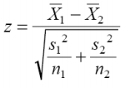
Collect and summarize data into a test statistic (z - statistics)
Hint :
For testing equality of two population means :

Slide 41
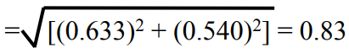
Z = 1.8 / 0.83 = 2.17

Slide 42
Determine the p-value.
You can use the z-table / negative z-table using below webpage
http://www.z-table.com/

Slide 43
The alternative hypothesis was two-sided
p-value = 2 × [proportion of bell-shaped curve 2.17]
proportion is about 2 × 0.015 = 0.03

Slide 44
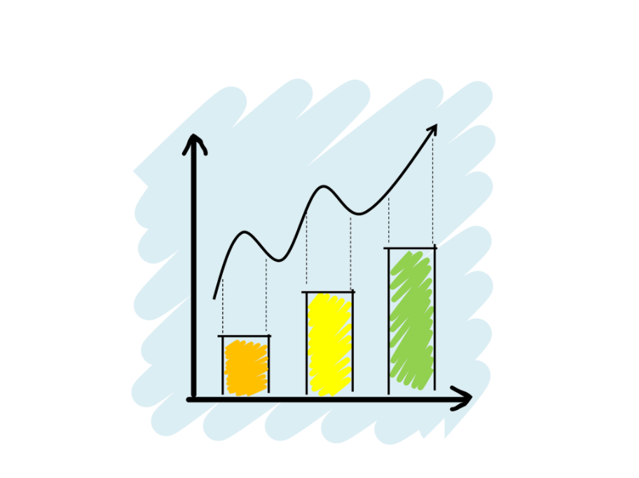
What is Exploratory Data Analysis?
“ Exploratory Data Analysis refers to the critical process of performing initial investigations on data so as to discover patterns, to spot anomalies, to test hypothesis and to check assumptions with the help of summary statistics and graphical representations.”
kinds of data source
Public data: Data collected by the government or other public agencies that are made public for the purposes of research are known as Public data.
Private data: Data generated by Banking, telecom, retail, and media are some of the key private sectors that rely heavily on data to make decisions.
Notes:
It is a good practice to understand the data first and try to gather as many insights from it. EDA is all about making sense of data in hand, before getting them dirty with it.
There are actually no shortcuts for data exploration. If you are in a state of mind, that machine learning can sail you away from every data storm, trust me, it won’t. After some point of time, you’ll realize that you are struggling at improving model’s accuracy. In such situation, only data exploration techniques will come to your rescue.
I can confidently say this, because I’ve been through such situations, a lot. To top all of that Recruiters love EDA ☺

Slide 45
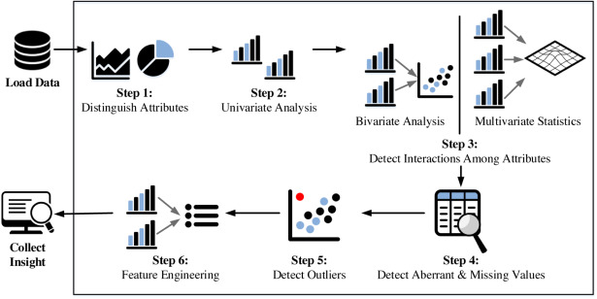

Fundamental steps of EDA process

Slide 46
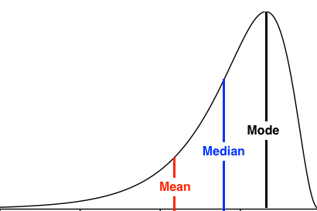

Measures of Central Tendency
“ The measure of central tendency is a single value that attempts to describe a set of data by identifying the central position within that set of data.”
Notes:
Mean : It susceptible to outliers when unusual values are added it gets skewed i.e. deviates from the typical central value.
Median : better alternative to mean as it is less affected by outliers and skewness of the data.
Mode: The mode is the most commonly occurring value in the dataset. The mode can, therefore sometimes consider the mode as being the most popular option.

Slide 47
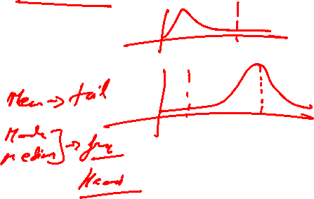
Poll
If a positively skewed distribution has a median of 50, which of the following statement is true?
A) Mean is greater than 50 B) Mean is less than 50 C) Mode is less than 50 D) Mode is greater than 50 E) Both A and C F) Both B and D
27-06-2021
11

Slide 48
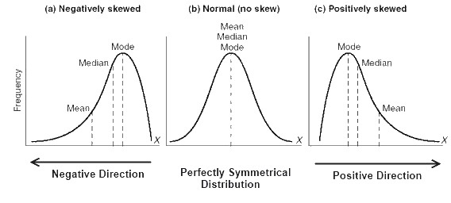
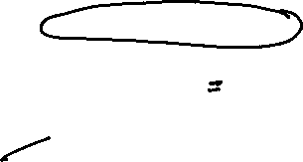
Poll
If a positively skewed distribution has a median of 50, which of the following statement is true?
A) Mean is greater than 50 B) Mean is less than 50 C) Mode is less than 50 D) Mode is greater than 50 E) Both A and C F) Both B and D
27-06-2021
11

Slide 49
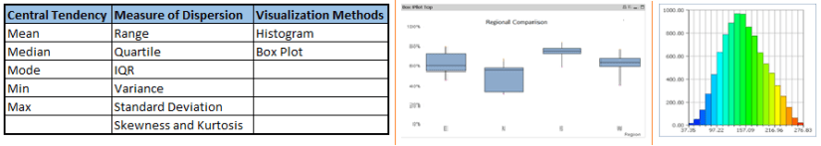
Univariate Analysis
At this stage, we explore variables one by one. Method to perform univariate analysis will depend on whether the variable type is categorical or continuous.

Slide 50
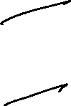
Poll
Please select the plots which could be used for univariate analysis
Histogram
Correlation matrix
Box-plot
Scatter plot
27-06-2021
11

Slide 51
Poll - solution
Please select the plots which could be used for univariate analysis
Histogram
Correlation matrix
Box-plot
Scatter plot
27-06-2021
11

Slide 52
Bi-variate Analysis
Bi-variate Analysis finds out the relationship between two variables. Here, we look for association and disassociation between variables at a pre-defined significance level. We can perform bi-variate analysis for any combination of categorical and continuous variables.
The combination can be:
Categorical & Categorical
Categorical & Continuous
Continuous & Continuous.

Slide 53
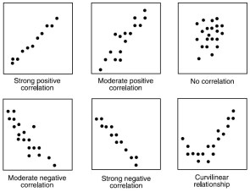
Continuous vs continuous
While doing bi-variate analysis between two continuous variables, we should look at scatter plots. It is a nifty way to find out the relationship between two variables. The pattern of scatter plot indicates the relationship between variables. The relationship can be linear or non-linear.

Slide 54

Categorical & Categorical
Stacked Column Chart: This method is more of a visual form of Two-way table.

Slide 55

Categorical & continuous
While exploring relation between categorical and continuous variables, we can draw box plots for each level of categorical variables

Slide 56

EDA
Poll 1
Please select a category which would lead to highest improvement in “Integration of Digital Technology” category?
Use of internet
Human Capital
Connectivity
Digital public services

Slide 57

EDA
Poll 1 (Answer)
Please select a category which would lead to highest improvement in “Integration of Digital Technology” category?
Use of internet
Human Capital
Connectivity
Digital public services

Slide 58


EDA

Slide 59


EDA
Question-1: What is the upper bound range of the total bill for the Smokers on Saturday?
● 28-45
● 30-50
● 38-50
Question-2: On which particular day the median total bill for both Smokers and Non-Smokers is approximately same?
● Thursday
● Friday
● Saturday
● Sunday

Slide 60

SQL

Slide 61

SQL

Slide 62

Python

Slide 63


Slide 64

#LifeKoKaroLift
Thank You!
References :
https://www.superprof.co.uk/resources/academic/maths
https://www.superprof.co.uk/resources/academic/maths
http://users.stat.ufl.edu/
https://www.surveygizmo.com/resources
https://courses.lumenlearning.com/introstats1/chapter/null-and-alternative-hypotheses/
https://www.ck12.org/book/CK-12-Advanced-Probability-and-Statistics-Concepts/
https://www.indiabix.com/data-interpretation

